Slide 1
The FT Web App and Automated Testing
Automated testing is good
Jim Cresswell (jim.cresswell@ft.com, @JimCresswell) Developer, FT Labs (@ftlabs)
Feb 2014
Notes:
Hi, I’m Jim Cresswell, I’m a developer working at the Financial Times, currently focusing on QA and test automation.
I’m going to talk about the Financial Times, FT Labs where I work, about testing and about the work we’ve done over the last 6 to improve our automated testing.

Slide 2
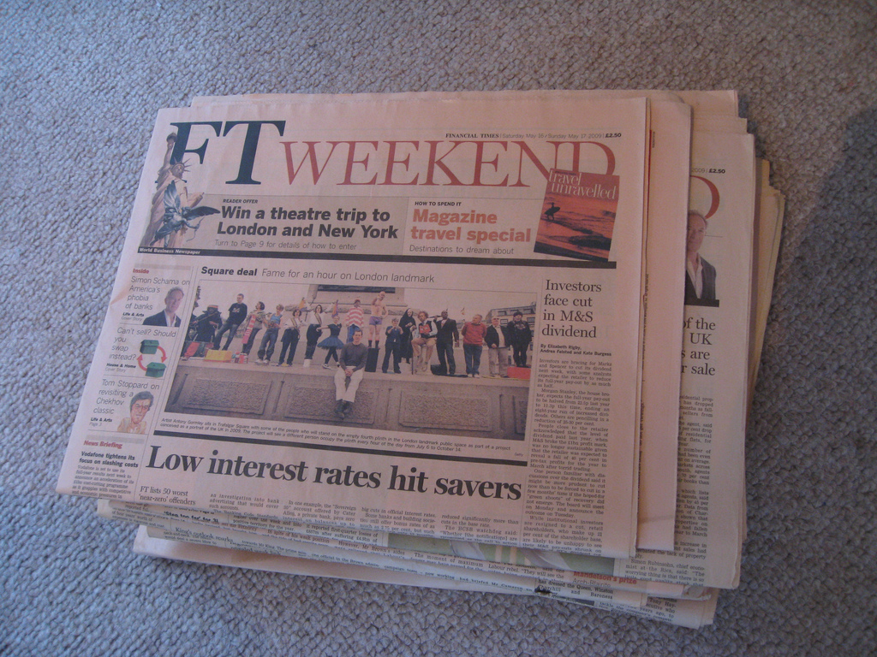
Notes:
This is the Financial Times, it is a newspaper but more it’s a collection of edited and curated content.
It has an average daily global audience across media of more than two million people. The majority of the FT’s subscribers consume the content in a digital format.

Slide 3

Welcome back to the web
The FT web app provides a touch optimised user experience.
Notes:
The primary means of digital consumption are ft.com and the FT’s web app. The web app used to look like this.

Slide 4

Notes:
It now looks more like this across all platforms, as of last week including the Android app. Here you see it with the iOS browser chrome, it also works as a full screen app.
What is a web app? It’s an app that is built with web technologies. If anyone would like to discuss that further let’s leave it until after the talk.

Slide 5
app.ft.com – same code everywhere.
Notes:
Why a web app? The web app code is cross platform, the same code base powers all the versions of the app on all the platforms on all the screen sizes.

Slide 6
app.ft.com – same code everywhere
Main platforms
iOS - iPhone and iPad – fullscreen web app
Android – Java wrapper
Windows 8 – HTML5 wrapper
Beta platforms
Most modern mobile and desktop browsers
Notes:
The cross-platform nature of the web does not solve every problem, and presents a few, but it was a good fit for the needs of the FT when it was considering pulling out of the iOS app store.
Our main platforms are iOS, Android and Windows 8, either as a web page or a web page embedded in a wrapper. But, if you type app.ft.com into a browser there is a good chance it will work.

Slide 7
FT Labs labs.ft.com github.com/ftlabs @ftlabs
Notes:
The web app is developed by FT Labs (née Assanka), a web research and development group within the FT.
For those interested here is the URL, our Github page with our open source software and our Twitter handle. These slides will be on the internet at some point so you can come back to this.

Slide 8
FT online numbers
The FT app has over 4 million users (subscribers and anonymous).
“[Digital] subscribers are increasing 24% year on year to almost 387,000.”
“Mobile devices now generate 60% of [digital] subscriber consumption, 40% of total traffic and a quarter of new digital subscriptions.”
Notes:
For context here are some numbers. There is free content on ft.com and in the app but it is largely a paid subscription service.
The FT focuses on digital first, and digital use is being driven by mobile.

Slide 9
FT app architecture
Offline capable Javascript/HTML/CSS front end, which talks to…
Largely PHP backend, which talks to…
FT content infrastructure.
Git, Github Enterprise, Jenkins.
Notes:
Very roughly the app architecture is javascript. HTML, CSS frontend and a PHP backend. To give you some idea of scale we have over 1100 files in the front end architecture, this is a software engineering project with software engineering problems to solve.
For version control we use Git and Github Enterprise which is the “host it yourselves” version of Github and Jenkins for continuous integration – if you aren’t familiar with continuous integration it largely means building and testing your project whenever it changes.

Slide 10
How do we stop it from breaking? Testing What sort of testing?
Notes:
How do we stop this complex product from breaking? Lots of testing, much of it now automated.
And here I am going to be talking about testing that the product interface and back end does as expected, rather than say network testing or stress testing or security testing, so unit tests, integration tests, functional tests. And generally I am going to be talk about automated tests although I will mention manual testing.
I do think there is more than one reason for testing product behaviour and I will talk more about that later.
So how much of what type of testing should we do? A very broad brush answer is “take a look at the software testing pyramid”…

Slide 11
Test Pyramid
Manual
Testing
Functional (GUI) Testing
Integration Testing
Unit Testing
Notes:
There are plenty of version of this diagram on the web. I made my own. The general idea is that you should do more of the faster to execute and cheaper to maintain automated tests at the bottom of the pyramid, and less of the slow to execute and expensive to maintain tests at the top of the pyramid.

Slide 12
What happens when you retrofit automated testing to a project?
Notes:
What happens if you have been largely relying on manual and you or someone decides that automation is cool now? You get…

Slide 13
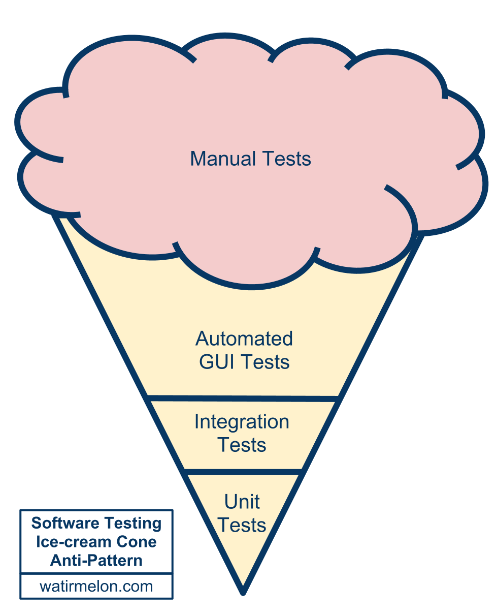
Test Ice-cream
Source:
Alister Scott
http://tiny.cc/testing-pyramid
Notes:
The test ice-cream!
A beautiful cloud of manual testing, with some manual test that have been automated, a maybe few software level tests thrown in their by the enthusiastic and perhaps some unit tests written by rebellious dreamers.
Credit to Alister Scott for either coming up with or reporting the ice-cream metaphor.
This arrangement is somewhat costly to maintain, somewhat slow to run, but a hell of a lot better than no automated tests at all, so if you have reached this point, well done! But you can go further.
***
For the FT app we have two test groups, the first one in house, and the second stage at the FT main office - effectively a user acceptance testing group with further manual and automated testing.
My focus is on the testing that happens before the product gets to the UAT stage, my main goal is to support developers and bore the UAT team.

Slide 14
What is the point of automated testing?
Notes:
So what are the point of tests? From my current perspective I think there are broadly three points.

Slide 15
What is the point of automated testing?
To speed up and aid in code design and refactoring.
To give fast feedback to developers – to flag problems while the developer is still thinking about the task.
Making sure the product isn’t broken - user acceptance testers should be bored (not really).
Notes:
Which are: to aid code design (that’s unit tests), to give fast developer feedback and to provide broad regression testing. The first one I would say is up to developers as it’s largely an implementation methodology. I’m more focused on the second two.
I’m not really trying to bore any manual testers. They should be given the kind of exploratory, intuitive, feeling based testing that only a human can do, because if your product has an API or a user interface then it’s humans that you are building for and humans that you want to keep happy.

Slide 16
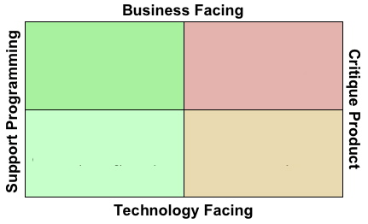
Testing quadrangle
Source: Brian Marick
http://www.exampler.com/old-blog/2003/08/21/#agile-testing-project-1
Notes:
Here is a more general expression of what testing can be for, first suggested by Brian Marick, the test quadrangle, which I am throwing in because I think it raises interesting questions.
Testing can support code design and refactoring and it can support critiquing the product. It can also test business requirements and technology or code requirements. I’d say that what we’ve done at Labs over the last 6 months has at least touched all those quadrants. This idea is relatively new to me and is definitely something I want to come back to.
One way of interpreting this diagram as stated by Alberto Savoia in a talk I’ll link to at the end of this talk is that the left represents ”testing you are building it right” and the right represents “testing you are building the right it”. You might argue that applies equally to the top and bottom of the diagram, for the mathematically inclined in the audience, I don’t think this is really an orthogonal basis set.

Slide 17
Where were we 6 months ago?
Notes:
So where was FT Labs 6 months ago?

Slide 18
Where were we 6 months ago?
Lots of manual testing.
No automated functional tests.
Quite a few automated integration (unitish) tests.
Notes:
We relied almost entirely on manual testing. We certainly had some code tests but they pertained to the back end code and the data it provided rather than the operation of the product UI. We had no automated functional tests.
With this setup we created a great product, but as we expanded to more platforms and more features and faster development this was becoming limiting.

Slide 19
Where are we today?
Notes:
And where are we today?

Slide 20
Where are we today?
Lots of manual testing – but finding many fewer issues and less serious issues.
Lots of automated functional tests.
Lots of automated integration (unitish) tests including…
JavaScript tests of required-in modules – see http://github.com/ftlabs
Notes:
We still have lots of manual testing – but we are finding fewer and less serious issues, there is more time for exploratory testing and finding weird edge cases or asking questions like “how does the app feel?” – feeling is important, if the app feels sluggish or annoying in some ill defined way then users will put it down.
On the web app, at the Labs stage, we have one manual tester. Almost everything he does is exploratory, there is no reliance on formal test plans, and it's great, he finds the problems that are hard to write algorithmic tests for. If he finds something repetitive to do he either automates it or writes down steps that could be automated.
We have automated functional tests, which I will talk more about in a moment.
We have still have code tests – We have more than before, features are generally not considered complete until they are well tested. For those who are interested we use Phing and PHPUnit for PHP tests, Grunt and/or npm and buster.js for Javascript tests.
A lot of our JavaScript is tested by pulling it out into a requireable module and testing that.

Slide 21
Automated functional testing
Notes:
Lots of the effort over the last 6 months has focused on creating a suite of automated functional tests.

Slide 22
Automated functional testing
Webdriver http://docs.seleniumhq.org/projects/webdriver/
Test in browsers, most of the problems we used to catch manually were cross-platform.
Tests are written in Java but could have been written in most languages.
Notes:
The functional tests use a tool called Webdriver, also known as Selenium 2, to test the app via its user interface.
Webdriver is a set of set of commands for manipulating the browser, a protocol for communicating those commands to the browser and an API within the browser to implement those commands.
We test in the browser, partially because most of the problems we find either manually or with automated tests are cross-platform, and partially because testing a web app or hybrid app on a device is hard – more about our aspirations in this area later.
The tests are written in Java but could just as easily have been written in JavaScript or Ruby or Python or even Perl. Java was chosen because that is the default implementation and tends to get the latest features first.
The functional test suite takes about twelve minutes to run including deployment of the app. We currently run 8 test classes in parallel on a mac mini, we want to make this a lot more scalable by using Selenium Grid to run all the test classes at once on many virtual machines, meaning that the time to feedback should never rise above about five minutes, hopefully less.

Slide 23
Jenkins
Notes:
For context: earlier I mentioned Jenkins and continuous integration.

Slide 24
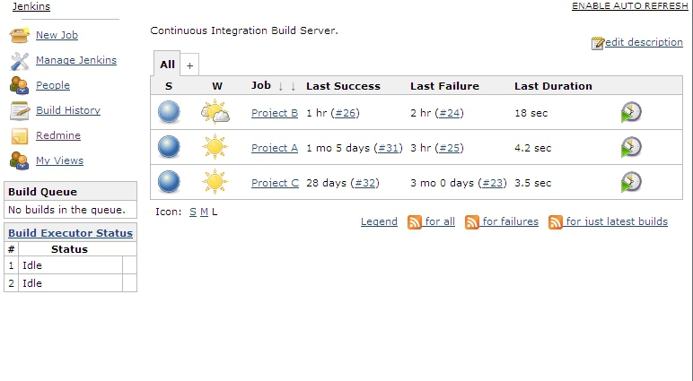
Builds passing
Notes:
For those who haven’t seen it before I wanted to show you what then Jenkins interface looks like. Jenkins acts a the instigator of tests and the place where we can see the results. Broadly speaking blue means that projects are healthy and tests are passing…

Slide 25
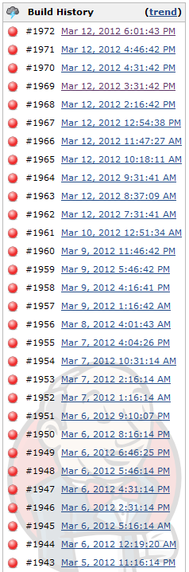
Builds failing
Notes:
Red means that Jenkins is not happy, and everyone should pay attention.

Slide 26
Pull requests and code reviews
Notes:
I have mostly talked about automated and manual testing. They are important, but an equally important and very powerful mechanism for improving code AND product quality over the last 6 months has been communal peer review review of pull requests.

Slide 27
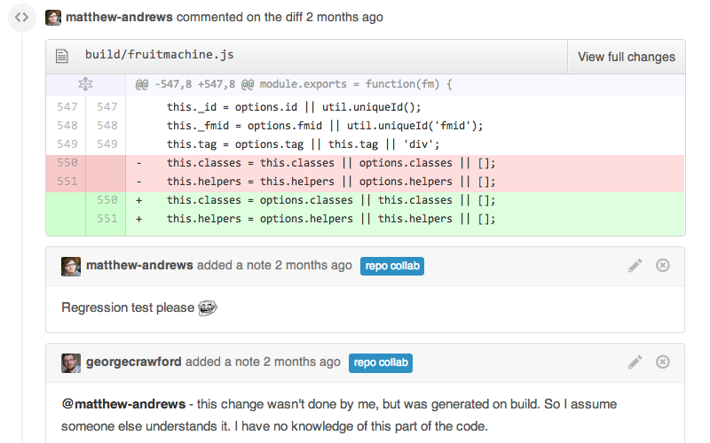
Pull requests and code reviews
Notes:
If people aren’t familiar with the concept a pull request is a request for changes from one branch of the code, usually a feature development branch, to be merged into the main version of the code.
Reviewing the code in pull requests is in Github and similar products, where everyone can see pull requests and everyone can comment on them - it’s been a great tool for teaching and learning. Here you can see two developers having a conversation about some proposed changes.

Slide 28
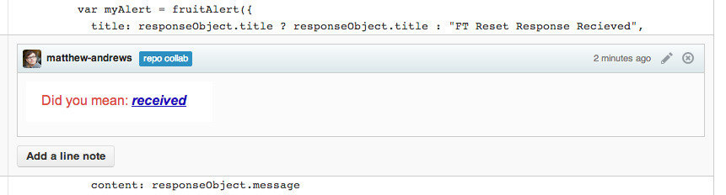
Pull requests and code reviews
Notes:
And here’s an example of a code review catching a fundamental issue.

Slide 29
When do we test?
Notes:
Now I think one of the most interesting questions is “when do we test?”

Slide 30
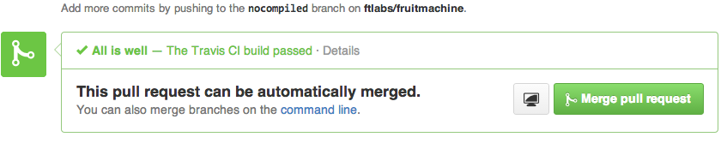
When do we test?
Before a commit is merged into the main branch.
When the main branch changes, and periodically outside working hours.
Hourly against the live product.
Notes:
We run tests before a commit is merged into the main branch. The important point is that we test the feature branch code, we test the code that would be created if the pull request was accepted. We never merge code that would “break the build” – this prevents broken code from holding up others developers doing work, once the broken code is fixed and we know it won’t cause problems then we can merge it.
If you are familiar with version control and a Github style workflow we test the potential merge product of pull-requests before accepting the request. There are currently maybe 2 or 3 commits an hour, so with a 12 minute run time you can see that we need to find a way to scale if we want larger teams to adopt this methodology.
The image show the results of passing tests being reported back to the Github UI, these results are from s system called Travis CI rather than Jenkins, but any kind of feedback to Github would look similar.
We also run tests whenever a change is merged to the main branch and at least hourly – partially to catch issues with infrastructure that were not caused by code changes.
And, on the basis that there is no fundamental difference between testing and monitoring we also run the functional tests against the live version of the app.

Slide 31
Where do we want to go?
Notes:
What do we want to achieve in the next 6 to 12 months?

Slide 32
Where do we want to go?
Continuous delivery – releasing one feature at a time.
Parallel testing on many browsers – Selenium grid.
Parallel testing on many devices.
A set of super fast code tests that runs whenever a developer hits save.
Total regression coverage - never hear about a problem from an external source twice.
Notes:
We’re steadily moving towards continuous delivery, releasing one feature at a time.
We want to use Selenium Grid to add scalable parallelism to our tests with the aim of minimising developer feedback time.
We are exploring the emerging tooling for testing web apps and hybrid apps such as appium, ios-driver and selendroid, I’ll give links to those at the end.
We want fast feedback to developers on hitting save, tools such a Grunt for JavaScript allow this.
We want zero tolerance on regressions, we never want to hear about the same problem from an external source twice.

Slide 33
Summary
Notes:
So, in summary…

Slide 34
Summary
Testing is good.
Automate what you can automate (without going nuts).
Pyramids are better than ice-cream. Ice-cream is better than nothing.
Manual testers should never be bored, give them the interesting stuff that a computer just can’t do.
Notes:
Testing is good. You probably knew that, but I think it helps to keep saying it.
Automation is also generally good. Consider the longer term repercussions of automation, is it going to save you time this week, this month, this year, is it going to mean you never break the same thing twice? Probably.
Don’t spend more time on expensive functional tests than you do on cheaper, faster code tests… unless you want to. Some automated testing is usually better than no automated testing.
People (and manual testers are people) are way better than computers at deciding what will annoy other people. You will always need manual testers.
Has it been worth it? Yes! We find far fewer problems now, the problems we find are less serious, or more subtle, we can focus on a level of quality that we couldn’t before. It’s been 6 months since we got a call from the UAT testers telling us that the app doesn’t load.

Slide 35
Reading and resources
Open source libraries http://github.com/ftlabs
Tutorials and articles http://labs.ft.com
On device GUI testing (web/hybrid/native) http://appium.io/ http://ios-driver.github.io/ios-driver/ http://selendroid.io/
“Test is dead” - Alberto Savoia http://www.youtube.com/watch?v=X1jWe5rOu3g
Notes:
Here’s a few links you might find interesting. The FT Labs open source libraries are on Github. There are some tutorials and articles on the labs website. And for anyone interested in testing web and hybrid apps (and in the case of Appium, native apps) here are some links to projects which are attempting to enable that. And I can recommend this talk by Alberto Savoia entitled “Test is Dead”.

Slide 36
Thanks!
Jim Cresswell
jim.cresswell@ft.com, @JimCresswell
Sound like fun?
labs.ft.com/jobs
Notes:
Thanks for listening!
If anyone is curious as to what the functional tests look like in action find me afterwards and I can give you a demo on my laptop.
And, if you are a test automation engineer and you want to move to London let me know.

